Slide 2

Hierarchical Multi-Stream Learning for Eye Movement-Based Schizophrenia Recognition: From Handcrafted Features to Bidirectional Graph-Transformer Ensembles
Team 13 : - Phạm Minh Tuyên - 20233885
- Lê Hà Hải Vân - 20233886
- Bùi Hoàng Giang – 20224307
Advisor: PGS. TS. Trần Th Thanh Hải | TA: ThS. Bùi Hạnh Trang

Slide 3
Work contribution table
Phase / Section | Task Name | Lead Members
Phase 1: Idea & Review | Literature Review | Ha-Hai-Van Le Minh-Tuyen Pham
 | Proposed Architecture Design | Ha-Hai-Van Le
Phase 2: Preprocessing | Preprocessing Pipeline Setup | Minh-Tuyen Pham
 | Gaze Distribution Statistics | Minh-Tuyen Pham
Phase 3: Feature Eng. | Stimulus-Level Feature Extraction (Tier 2A) | Ha-Hai-Van Le Minh-Tuyen Pham
 | Delta Feature Design (Tier 2B) | Ha-Hai-Van Le Minh-Tuyen Pham
Phase 4: Tabular Models | GBDT Model Training | Ha-Hai-Van Le
 | SHAP Explainability Analysis | Ha-Hai-Van Le Minh-Tuyen Pham
Phase 5: Deep Models | GNN-CEFAM Pipeline (Tier 4A) | Ha-Hai-Van Le Minh-Tuyen Pham
 | BiCA-HS Pipeline (Tier 4B) | Ha-Hai-Van Le Minh-Tuyen Pham
 | Parameter Sweep & Experiments | Ha-Hai-Van Le Minh-Tuyen Pham
Phase 6: Meta-Learner | Meta-Learner Construction (Tier 5) | Ha-Hai-Van Le
 | Mathematical Analysis | Ha-Hai-Van Le Minh-Tuyen Pham
Phase 7: Drafting & Slides | Paper Drafting | Ha-Hai-Van Le Minh-Tuyen Pham
 | Review Revisions | Ha-Hai-Van Le Minh-Tuyen Pham
 | Slides Preparation | Hoang-Giang Bui

Slide 4
Outline
1
Introduction
2
Related Works
3
Data Construction
4
Proposed Method
5
Experimental Results
6
Conclusion & Future Work
7
References
2

Slide 5
Section 1
Introduction
Schizophrenia * Eye Tracking * Motivation

Slide 6
Introduction -- Schizophrenia & Eye Movement Biomarkers
What is Schizophrenia?
Why Eye Movements?
Severe neuropsychiatric disorder affecting ~1% of the global population
Characterized by deficits in:
- Cognitive control
- Social cognition
- Visual attention
Clinical diagnosis remains largely qualitative & subject to inter-rater variability
Need for objective, quantifiable biomarkers
Atypical eye movements are among the most replicated neurobiological markers of schizophrenia (Holzman et al., 1973)
SZ patients exhibit:
- Restricted visual exploration
- Social gaze avoidance
- Abnormal saccadic dynamics
Free-viewing tests: non-invasive, low-cost, clinically actionable
EyeLink 1000 Plus @ 1000 Hz captures precise fixation sequences
4

Slide 7
Introduction -- Limitations & Research Questions
Current Limitations
Handcrafted methods: discard spatiotemporal structure
CNN/density-map models: collapse temporal ordering
No integration of clinical biomarkers + deep learning
Existing SOTA (MSNet): AUC = 0.8854
Research Questions
RQ1
Are handcrafted clinical features (135-dim expert vector) sufficiently discriminative to separate SZ from HC?
RQ2
Does graph-based spatiotemporal modeling (GNN + cross-attention) improve over tabular baselines?
RQ3
Can a hybrid Graph-Transformer ensemble with meta-learning surpass the published MSNet SOTA?
Our Contributions:
(1) 135-dim expert vector with 60 delta features * (2) GNN-CEFAM with genuine cross-attention * (3) BiCA-HS Transformer-expert fusion * (4) Tier 5 meta-learner ensemble
5

Slide 8
Section 2
Related Works
Prior Art * Limitations * Our Gap

Slide 9
Related Works
Method / Paper
Approach
Strength
Limitation
Spigelman et al. (2008)
SVM on scanpath statistics
Simple, interpretable
Loses spatiotemporal structure
Huang et al. (2020)
Discriminative eye-movement features + model-metric
Rich handcrafted features
No sequence/graph modeling
Tseng et al. (2013)
Multi-population classifier on gaze
High-throughput classification
Static aggregation, no temporal
Birawo & Kasprowski (2024)
Graph attention on scanpath
Models spatial topology
No clinical biomarker integration
Song et al. (2025) [SOTA -- MSNet]
Multi-scale CNN on gaze density maps
AUC = 0.8854 (published)
Collapses temporal order; no fixation-level interpretability
Gap: No prior work jointly integrates handcrafted clinical biomarkers, graph topology, and Transformer sequence modeling in a principled ensemble.
6

Slide 10
Section 3
Data Construction
Dataset * Preprocessing * Feature Engineering

Slide 11
Data Construction -- EMS Dataset & Preprocessing
EMS Dataset Overview
Preprocessing Pipeline
208
Total Subjects (104 SZ + 104 HC)
Raw Eye-Tracking Data
293,740 fixations (EyeLink .xlsx files)
1000 Hz
EyeLink 1000 Plus sampling rate
100
Naturalistic stimuli per subject
Spatial Filter
Remove fixations outside 1024x768 screen 5,037 removed (1.71%)
4
Stimulus categories
293,740
Raw fixations collected
Temporal Filter
281,037
Clean fixations after filtering
Remove fixations < 50 ms (post-saccadic tremor artifacts) 7,666 removed (2.66%)
160
Labeled subjects for training (80 SZ / 80 HC)
Clean Fixation Data
48
Held-out blind test subjects
281,037 fixations ready for feature extraction
Stimulus Categories:
Social
Natural
Synthetic
Manipulated
9

Slide 12
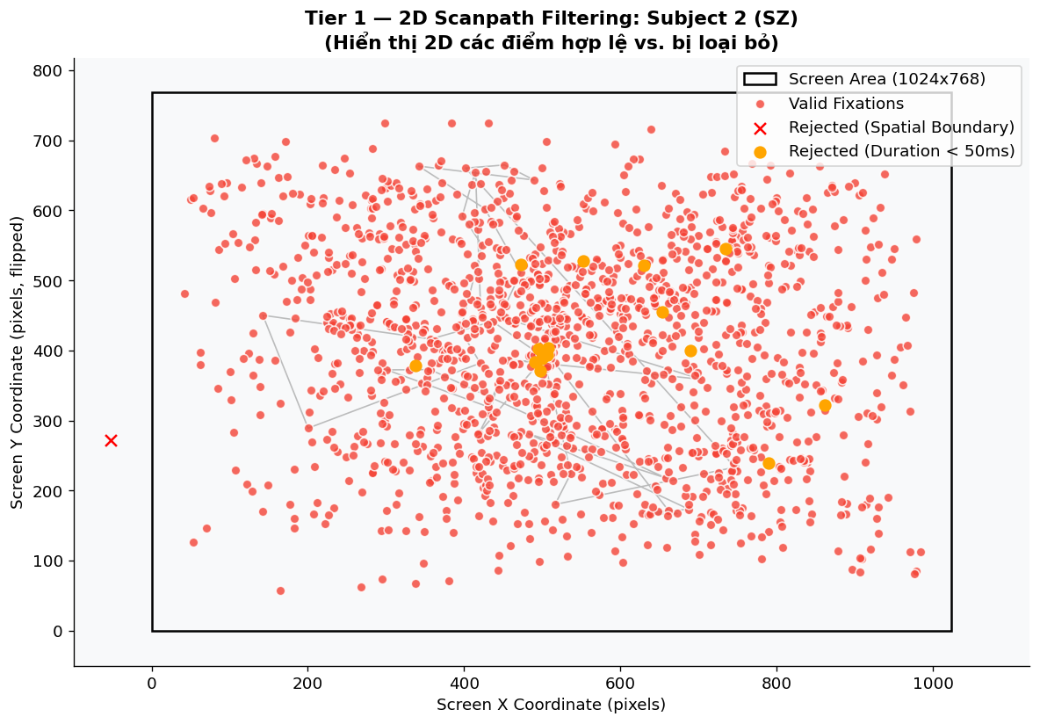
Data Construction -- Tier 1: Spatial Filtering Visualization
Subject 2 (SZ): red = valid fixations; x = spatial rejections (outside 1024x768 screen); orange = temporal rejections (< 50 ms). 5,037 fixations removed spatially (1.71%) and 7,666 temporally (2.66%) across the full dataset, yielding 281,037 clean fixations.

Slide 13
Data Construction -- Feature Engineering (135-dim Expert Vector)
Tier 2A -- Stimulus-Level Features (15 features)
Tier 2B -- Contextual Delta Features (120 features)
Fixation Statistics
100 EMS stimuli -> 4 categories:
count, mean/median/std of duration
Social (Soc) * Natural (Nat)
Saccade Dynamics
Synthetic (Syn) * Manipulated (Man)
amplitude, mean/std; SA-FDR ratio; mean turning angle
Per subject x stimulus -> 15 features
Scanpath Geometry
Averaged per category -> 60 category-mean features
total length, center bias, convex hull area, 2D spatial entropy (10x10 grid)
Pupil Dynamics
4 cross-category delta features per metric:
mean, std, coefficient of variation (CV)
dSoc-Nat, dMan-Nat, dSoc-Syn, dMan-Syn
-> 60 delta features
SHAP analysis confirms dSoc-Nat fixation count
and center bias are top CatBoost predictors
15
+
60
+
60
=
135-dim
Stimulus-level features
Category-mean features
Delta (dCategory) features
Expert Vector x_exp
Sample Subject Trace:
Subject 001 -> Raw fixations (293 pts) -> Filtered (271 pts) -> 15 stimulus features per trial -> 135-dim vector -> Model Input
Raw .xlsx
->
Spatial Filter
->
Temporal Filter
->
Feature Extract.
->
135-dim Vector
->
Graph / Model
11

Slide 14
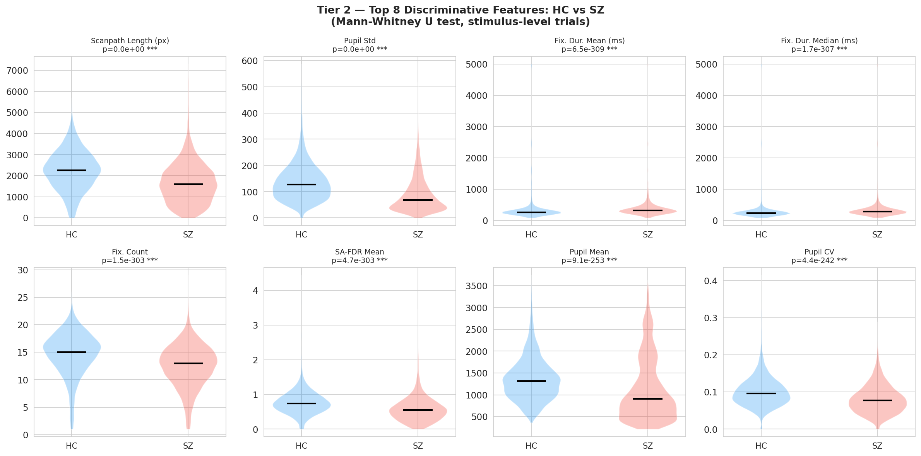
Data Construction -- Tier 2: Feature Distributions HC vs SZ (Violin + Mann-Whitney U)
Top 8 discriminative stimulus-level features. All highly significant (p <= 4.4e-242). HC shows higher scanpath length, fixation count, and pupil variability -- consistent with restricted visual exploration in SZ.

Slide 15
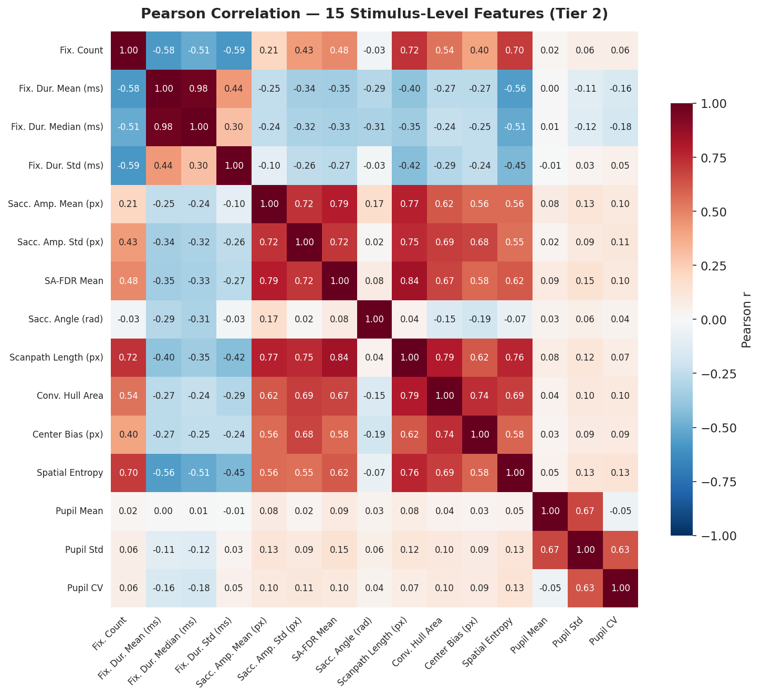
Data Construction -- Feature Correlation Matrix (Pearson r, 15 Stimulus-Level Features)
Fixation/scanpath features form one correlated block (upper-left); pupil features form another (lower-right). Cross-block |r| < 0.20 -- near-orthogonal contributions, no multicollinearity. Confirms complementary diagnostic value of the four feature domains.

Slide 16
Section 4
Proposed Method
Hierarchical 5-Tier Framework

Slide 17
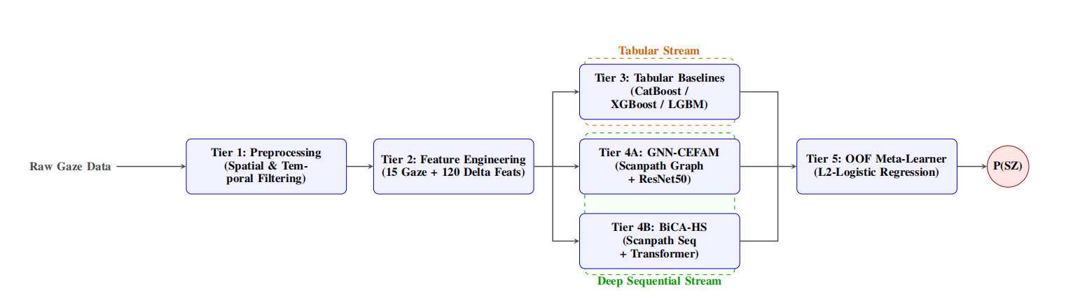
Overview: Hierarchical 5-Tier Framework

Slide 18
Proposed Method -- Hierarchical 5-Tier Framework
Tier 1
Preprocessing
Spatial + Temporal Filtering
Tier 2
Feature Engineering
135-dim Expert Vector (15 + 60 + 60 delta)
Tier 3
Tabular GBDT Baselines
XGBoost * LightGBM * CatBoost
Tier 4A
GNN-CEFAM
Graph Attention + Cross-Attention Enhanced Fusion (on 135-dim expert)
Tier 4B
BiCA-HS
Bidirectional Cross-Attention Hybrid Stream (Transformer + expert)
Tier 5
Meta-Learner
OOF Logistic Regression Ensemble (CatBoost + BiCA-HS)
OOF cross-validation (GroupKFold, 4 folds) ensures zero data leakage across all tiers
Output: P(SZ) -- Diagnostic probability per subject
15

Slide 19
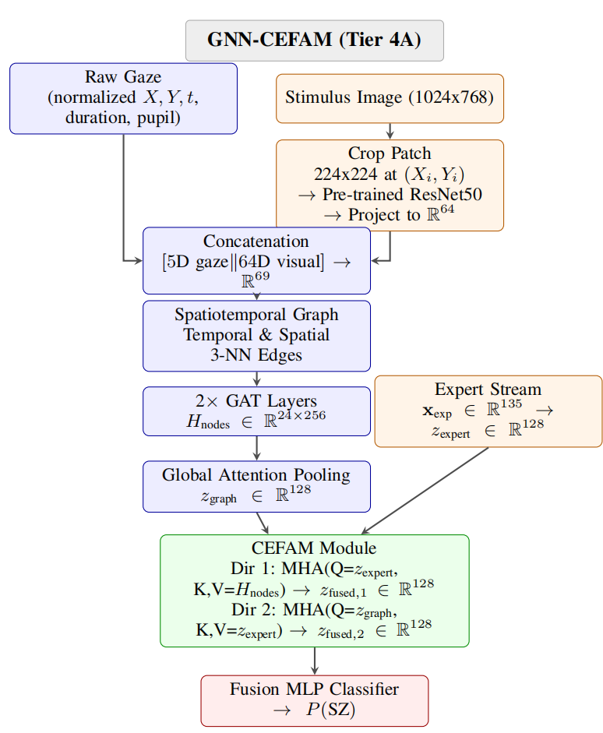
Proposed Method -- Tier 4A: GNN-CEFAM

Slide 20
Proposed Method -- Tier 4A: GNN-CEFAM
Architecture
Key Innovations
Input
Fixation sequence T x 5-dim (X, Y, duration, pupil, dpupil)
Non-Degenerate Cross-Attention
Prior work unsqueezes both streams to seq_len=1 -> softmax = 1.0 -> no learning signal. CEFAM queries expert over pre-pooling node sequence H_nodes in R^{Nx256}
Graph G=(V,E)
Nodes: fixation patches -> ResNet50 -> R69 Edges: temporal + spatial k-NN (k=3)
Dual Edge Types
2x GAT Layers
4 attention heads each H_nodes in R^{Nx256}
Temporal edges (v_i->v_{i+1}) capture scanpath order Spatial k-NN edges connect fixations in 2D space
Global Attn Pool
z_graph in R128
Attention Sparsity
Focal loss (a=0.5, g=2.0) + entropy penalty on attn weights (l=0.01) -> interpretable fixation saliency maps
Expert Stream
x_exp (135-dim) -> MLP -> z_expert in R128
CEFAM
Dir.1: Expert->Graph nodes (attn1) Dir.2: Graph->Expert (degenerate, seq=1)
Training Protocol
AdamW (lr=5e-4, decay=1e-4) CosineAnnealingWarmRestarts Early stopping on OOF AUC
Fusion MLP
z_fused in R256 -> P(SZ)
16

Slide 21
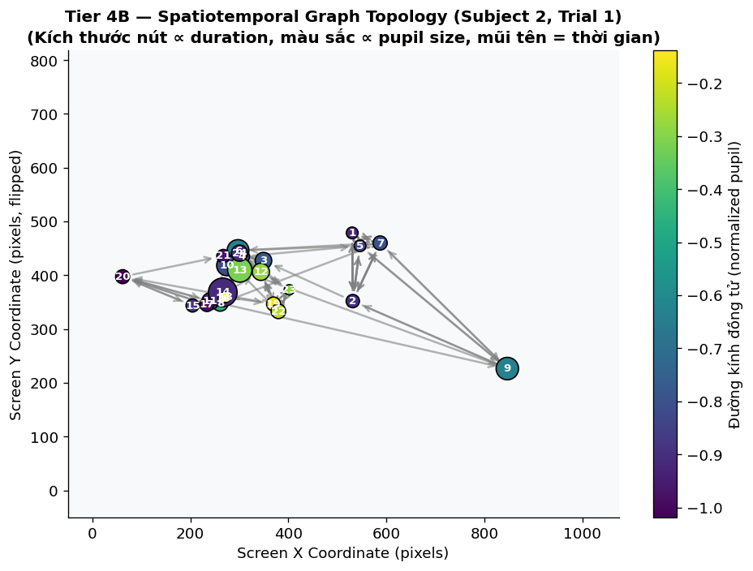
Proposed Method -- GNN-CEFAM: Spatiotemporal Fixation Graph (Subject 2, Trial 1)
Node size proportional to fixation duration; color proportional to normalized pupil size; arrows = temporal scan order. k-NN spatial edges (k=3) added alongside temporal edges. Graph fed into 2x GAT layers (4 heads) -> H_nodes in R^{Nx256}.

Slide 22
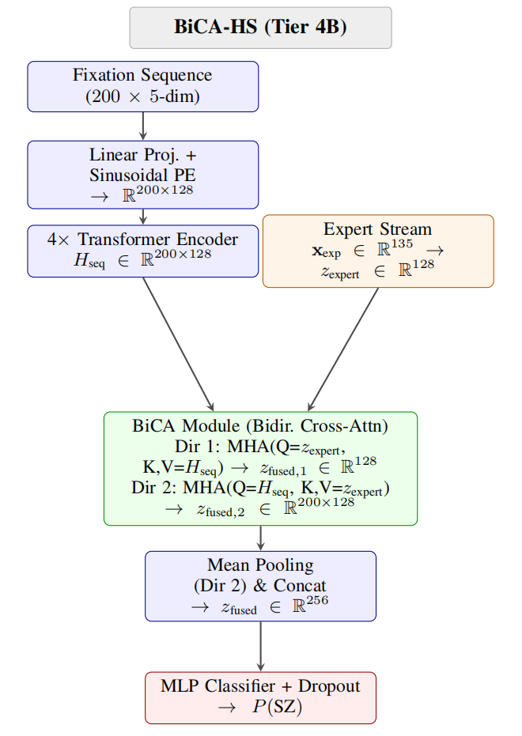
Proposed Method -- Tier 4B: BiCA-HS (Bidirectional Cross-Attention Hybrid Stream)

Slide 23
Proposed Method -- Tier 4B: BiCA-HS (Bidirectional Cross-Attention Hybrid Stream)
Architecture
Why BiCA-HS Outperforms GNN-CEFAM
Input
Fixation seq. 200 x 5-dim (no ResNet50) -> handles >8x more fixations than CEFAM
Longer Context
200 fixations vs. 24 for GNN-CEFAM -> captures full scanpath trajectory
Linear Proj + Sinusoidal PE
-> R^{200x128}
No Degenerate Dir.2
4x Transformer Encoder Layers
H_seq in R^{200x128}
Both BiCA directions are meaningful (seq_len=200, not 1)
Expert Stream
x_exp (135-dim) -> MLP -> z_expert in R128
No ResNet50
Eliminates visual feature extraction overhead; faster training, stable convergence
BiCA Module
Dir.1: Expert queries Seq (expert-guided attention) Dir.2: Seq queries Expert (sequence-guided expert) z_fused in R256
Stable Convergence
Converges across all 12 fold x seed runs (CV_AUC = 0.024 vs 0.032 for CEFAM)
Mean Pool + Concat -> MLP
-> Dropout -> z_final
Better Calibration
Classifier
-> P(SZ)
ECE = 0.031, Brier = 0.088 -> probabilities usable as clinical risk scores
18

Slide 24
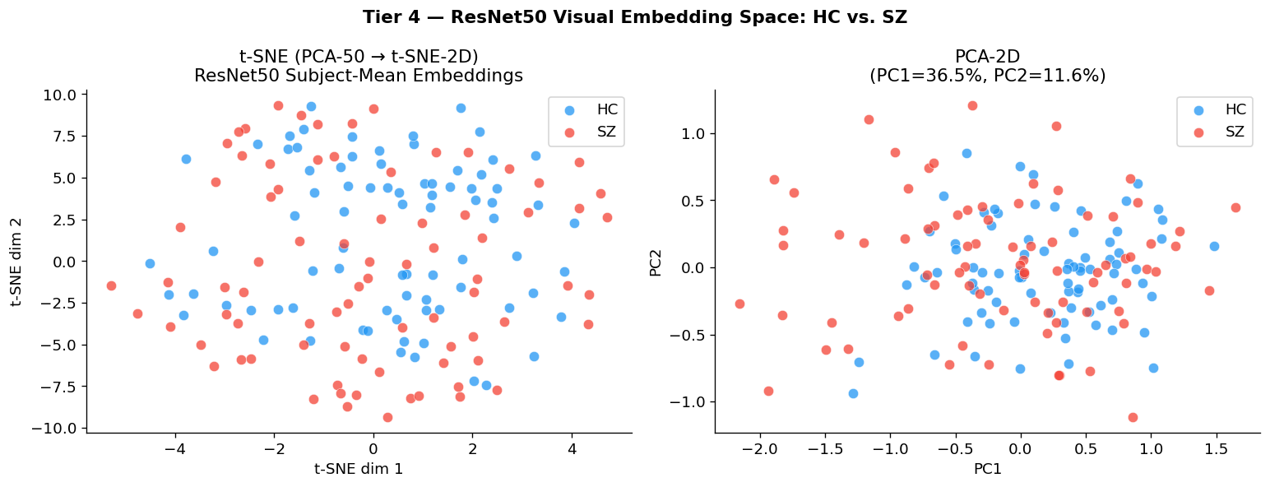
Proposed Method -- Why Temporal Modeling? t-SNE & PCA of ResNet50 Visual Embeddings
SZ (red) and HC (blue) subject-mean ResNet50 embeddings are heavily mixed in both t-SNE and PCA space. Raw patch-level visual features cannot discriminate schizophrenia -- confirming that temporal trajectory modeling (BiCA-HS) is essential.

Slide 25
Proposed Method -- Tier 5: OOF Meta-Learner Ensemble
Meta-Learning Strategy
Why OOF?
1. Collect Out-of-Fold (OOF) predictions from:
- CatBoost (P_tab) -- strong clinical feature model
- BiCA-HS (P_bica) -- best deep model
2. Protocol: 4-fold GroupKFold (fixed by Train_Valid.xlsx)
-> Zero data leakage guaranteed
-> Each subject in exactly one validation fold
3. Fit L2-regularized Logistic Regression:
P_final = sigmoid(b_tab*P_tab + b_bica*P_bica + b)
4. b_tab and b_bica quantify the relative contribution
of clinical biomarkers vs. deep temporal trajectories
Prevents training the meta-learner
on the same data used to train
base models
Each subject's OOF probability is
from a model that never saw it
during training
Comparable to stacked cross-
validation generalization
Tier 5 Ensemble Result
0.9590 +/- 0.0009
88.5% +/- 0.3%
88.8% +/- 3.1%
88.3% +/- 3.1%
AUC +0.074
AUC
ACC
Sensitivity
Specificity
vs. MSNet
20

Slide 26
Section 5
Experimental Results
Setup * Results * Ablation * Interpretability

Slide 27
Experimental Results -- Setup & Evaluation Protocol
Dataset Split
Evaluation Protocol
208 subjects total (EMS dataset)
160 labeled: 80 SZ + 80 HC -> Training
48 subjects held-out -> Blind Test
(labels withheld by dataset curators)
4-fold GroupKFold (folds fixed by
Train_Valid.xlsx) -> no subject overlap
Out-of-Fold (OOF) cross-validation
on 160 training subjects
Results reported as mean +/- std
across 3 seeds (42 / 123 / 456)
Each model: 12 fold x seed runs
Threshold: default t=0.50 (reported),
optimal t (Youden J) also computed
Evaluation Metrics
AUC
Accuracy
Sensitivity
Specificity
F1-Score
ECE / Brier
Primary
(TPR)
(TNR)
Calibration
Seeds: 42 / 123 / 456 -- Results are mean +/- std over 12 fold x seed combinations
Models Evaluated:
XGBoost * CatBoost * ST-GNN * GNN-CEFAM (Ours) * BiCA-HS (Ours) * Tier5+BiCA (Ours) vs. MSNet (SOTA)
22

Slide 28
Experimental Results -- OOF Performance Comparison
Model
AUC
ACC %
Sensitivity %
Specificity %
F1
MSNet [SOTA]+
0.8854
81.25
--
--
--
XGBoost
0.872+/-0.005
77.7+/-1.1
77.5+/-2.0
77.9+/-1.6
0.777+/-0.012
CatBoost
0.899+/-0.001
81.0+/-0.8
78.3+/-0.6
83.8+/-1.0
0.805+/-0.008
ST-GNN
0.933+/-0.009
79.0+/-0.3
63.3+/-0.6*
94.6+/-0.6
0.751+/-0.004
GNN-CEFAM (Ours)
0.921+/-0.006
85.0+/-1.6
85.0+/-1.0
84.2+/-2.1
0.847+/-0.009
BiCA-HS (Ours)
0.955+/-0.004
87.3+/-1.3
87.5+/-4.7
87.1+/-2.1
0.873+/-0.017
Tier5+BiCA (Ours)
0.959+/-0.001
88.5+/-0.3
88.8+/-3.1
88.3+/-3.1
0.886+/-0.004
+ MSNet AUC reported on 48-subject blind test; our OOF is on 160 training subjects
* ST-GNN achieves only 63.3% sensitivity at t=0.50 despite AUC=0.933 -- systematic HC bias
Tier5+BiCA achieves AUC = 0.9590 +/- 0.0009 -- surpassing MSNet SOTA by +0.074 AUC and improving clinical sensitivity to 88.8% +/- 3.1%
23

Slide 29
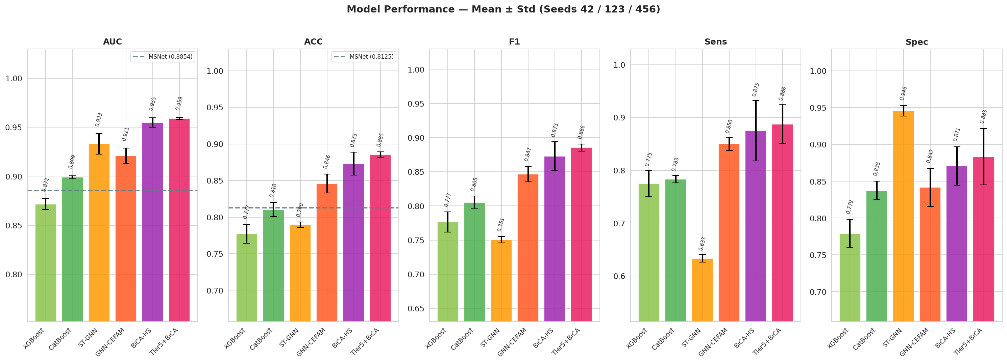
Experimental Results -- Model Performance: AUC / ACC / F1 / Sensitivity / Specificity
Mean +/- std over seeds 42/123/456. MSNet SOTA baselines shown as dashed lines (AUC=0.8854, ACC=81.25%). All proposed models exceed SOTA. Tier5+BiCA achieves highest AUC (0.959) and ACC (88.5%). ST-GNN's low sensitivity at t=0.50 is a calibration artefact.

Slide 30
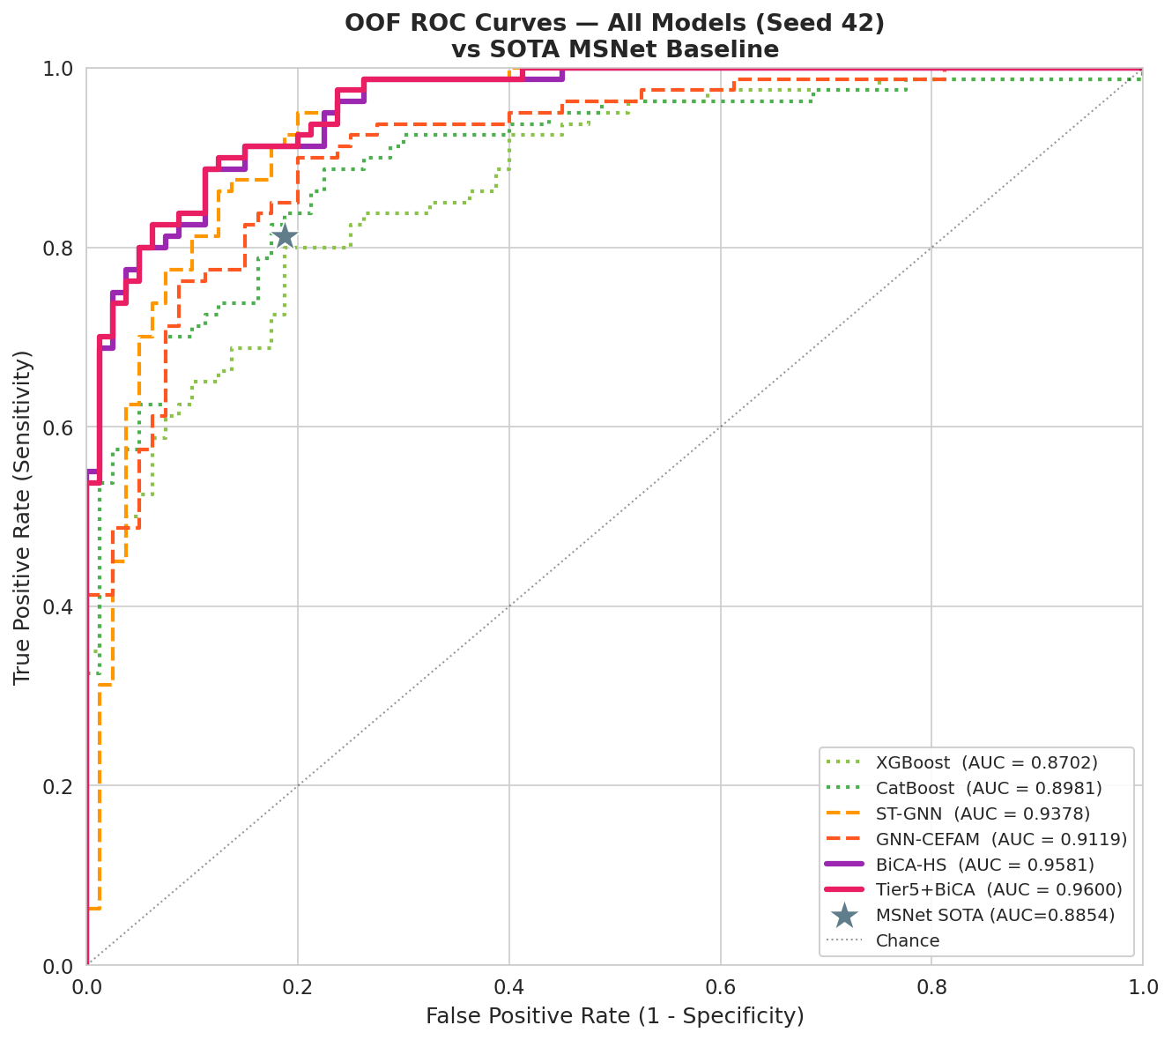
Experimental Results -- OOF ROC Curves vs MSNet SOTA Baseline (Seed 42)
BiCA-HS (AUC=0.9581) and Tier5+BiCA (AUC=0.9600) dominate the upper-left region. MSNet reported operating point shown for reference. ST-GNN's imbalanced sensitivity/specificity at t=0.50 is visible.

Slide 31
Experimental Results -- Ablation Study: Component Contribution
Component Contribution
Fold Stability (4-fold CV)
Comparison
dAUC
dACC
Interpretation
Model
Mean AUC
Std AUC
CV AUC
CEFAM Fusion vs GNN-Only
-0.026
-0.025
CEFAM fusion adds overhead over pure GNN
GNN-CEFAM
0.941
0.033
0.035
GNN Stream vs Tabular
+0.042
+0.044
Graph topology adds +4.2% AUC over CatBoost
ST-GNN
0.944
0.033
0.034
BiCA-HS
0.963
0.023
0.024
Transformer vs GAT
+0.046
+0.038
Transformer encoder outperforms graph attention
BiCA-HS has lowest CV_AUC = 0.024 (most stable across folds)
BiCA-HS full vs ST-GNN
+0.020
+0.013
Bidirectional cross-attention + expert stream gains
Per-Category AUC (BiCA-HS):
AUC Progression:
0.958
0.956
0.956
0.958
0.899
0.933
0.921
0.958
0.959
Social
Manipulated
Natural
Synthetic
CatBoost
ST-GNN
GNN-CEFAM
BiCA-HS
Tier5+BiCA
26

Slide 32
Experimental Results -- Research Questions Answered
RQ1: Are handcrafted clinical features (135-dim expert vector) sufficiently discriminative?
CatBoost on 135-dim features: AUC = 0.899 -- already exceeds MSNet SOTA (0.885)
SHAP confirms dSoc-Nat fixation count and center bias as top predictors
15 stimulus-level features correlate (|r| < 0.6), confirming near-orthogonal contributions
YES: Handcrafted features alone provide strong discriminative signal
RQ2: Does graph-based spatiotemporal modeling improve over tabular baselines?
ST-GNN (GNN only): AUC = 0.933 (+0.034 over XGBoost)
Graph topology contribution: +0.042 AUC, +0.044 ACC vs tabular only
ST-GNN suffers HC bias: 63.3% sensitivity at t=0.50 -> requires recalibration
YES: Spatiotemporal graph modeling adds significant value but calibration matters
RQ3: Can a hybrid Graph-Transformer ensemble with meta-learning surpass published MSNet SOTA?
BiCA-HS: AUC = 0.955 (+0.070 over MSNet)
Tier5+BiCA: AUC = 0.9590 +/- 0.0009 -- exceeds MSNet by +0.074
Sensitivity 88.8% +/- 3.1% (vs. MSNet benchmark on separate blind test)
YES: Bidirectional cross-attention + meta-learning ensemble surpasses SOTA
27

Slide 33
Experimental Results -- Interpretability & Calibration
SHAP Feature Importance (CatBoost)
Attention Maps (GNN-CEFAM)
Top predictors identified by SHAP beeswarm:
1. dSoc-Nat fixation count (rank #1)
2. dSoc-Nat center bias
3. Category-mean fixation duration (Nat)
4. Pupil diameter variability (Man)
5. Social scene fixation count
Clinical insight: SZ patients show reduced
social scene exploration relative to natural
scenes -- consistent with social gaze avoidance
deficits linked to frontal-striatal dysfunction
attn1 weights (Direction 1: Expert->Nodes)
provide fixation-level saliency scores
Entropy sparsity penalty (l=0.01) encourages
sparse attention -> interpretable maps
HC subjects: attention concentrated on
socially salient regions (faces, text)
SZ subjects: diffuse background-directed
attention pattern observed
Probability Calibration (Tier5+BiCA)
0.031
0.088
~diagonal
ECE
Brier Score
Reliability
BiCA-HS output probabilities can be interpreted as clinical risk scores without post-hoc calibration -- enabling threshold-free deployment
ROC Comparison Summary:
Tier5+BiCA and BiCA-HS dominate the upper-left region of the ROC curve vs all baselines. ST-GNN's high specificity / low sensitivity at t=0.50 is visible -- confirming the systematic HC bias that disappears only at optimal threshold.
28

Slide 34
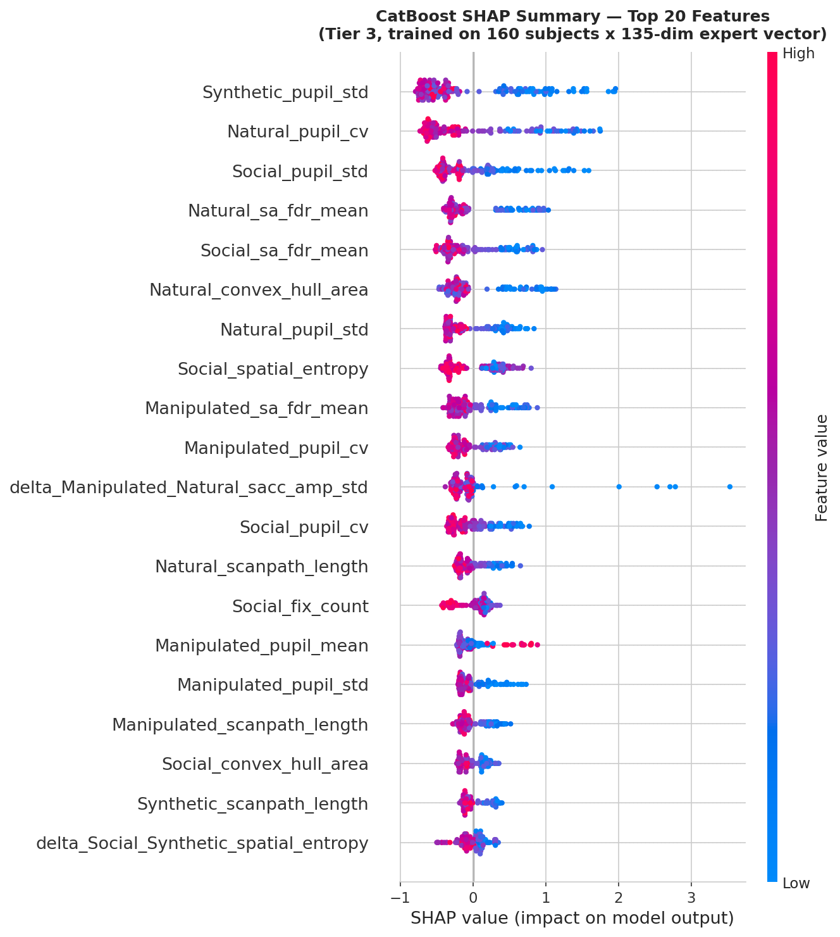
Explainability (XAI) -- SHAP Summary Plot: CatBoost Top 20 Features
Beeswarm plot on 160 subjects x 135-dim expert vector. Top global predictors: Synthetic_pupil_std, Natural_pupil_cv, Social_pupil_std, SA-FDR features. High pupil_std consistently pushes predictions toward SZ -- dysregulated pupil dynamics are the strongest biomarker.

Slide 35
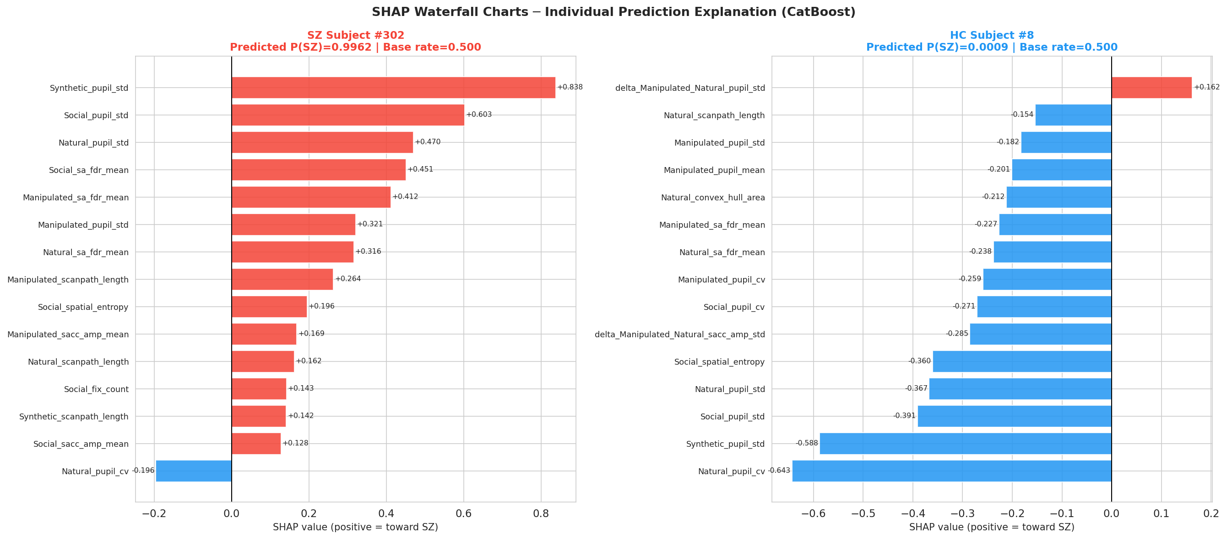
Explainability (XAI) -- SHAP Waterfall: Individual Prediction (SZ #302 vs HC #8)
Left: SZ #302 -- P(SZ)=0.9962; pupil_std and SA-FDR across all categories drive prediction to SZ. Right: HC #8 -- P(SZ)=0.0009; Natural_pupil_cv and Social_pupil_std drive to HC. Per-subject explanation enables clinically interpretable predictions.

Slide 36
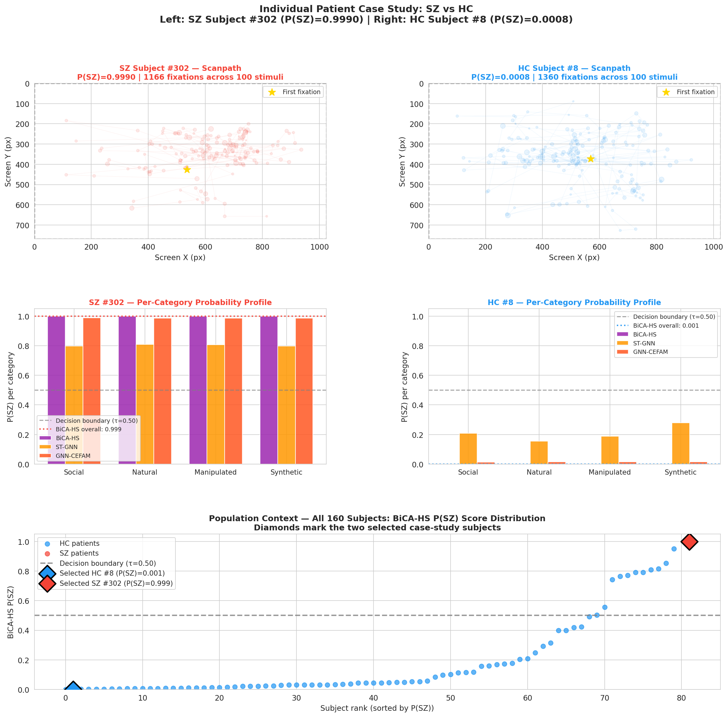
Explainability (XAI) -- Case Study: SZ Subject #302 vs HC Subject #8
Top: scanpaths -- SZ has restricted center-biased exploration (1166 fixations); HC has wider spatial coverage (1360 fixations). Middle: per-category P(SZ) profile -- BiCA-HS correctly classifies both subjects across all 4 stimulus categories. Bottom: population context (BiCA-HS P(SZ) distribution, 160 subjects).

Slide 37
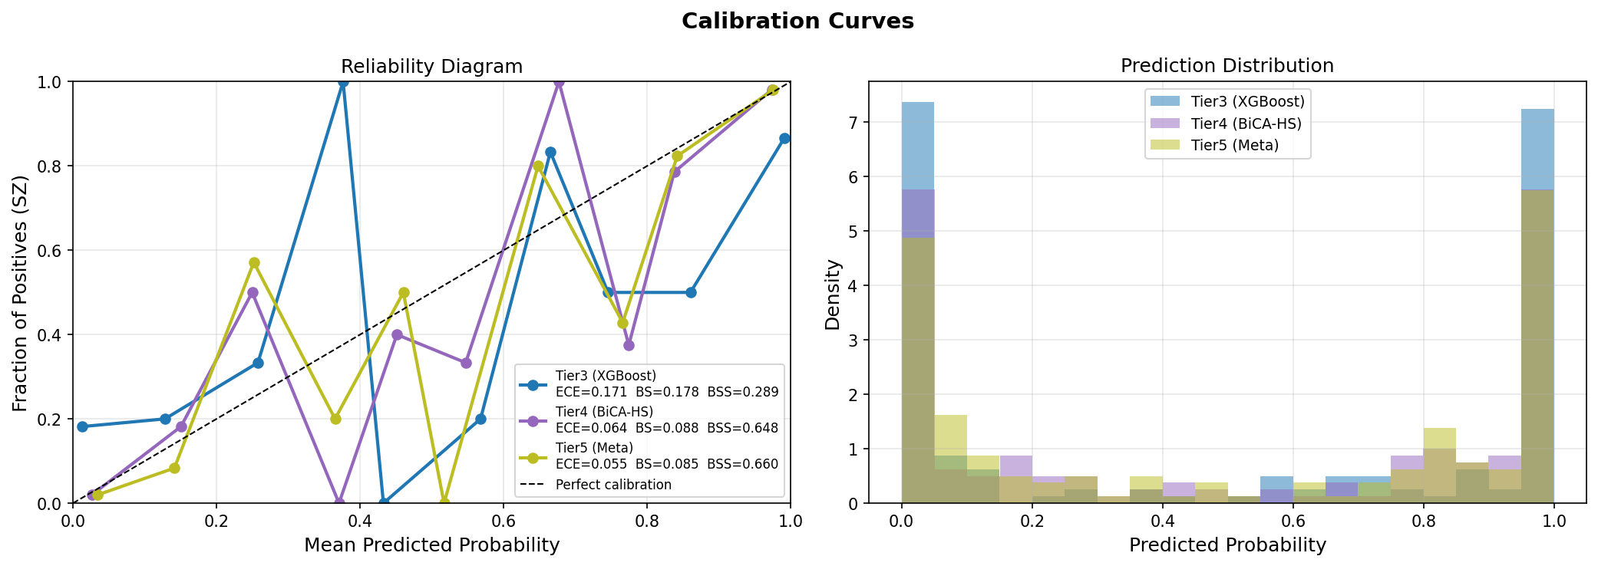
Experimental Results -- Calibration: Reliability Diagram & Prediction Distribution (Seed 42)
XGBoost (ECE=0.171) is poorly calibrated. BiCA-HS (ECE=0.064) and Tier5/Meta (ECE=0.055) track the diagonal closely. Output probabilities can be used directly as clinical risk scores without post-hoc calibration.

Slide 38
Section 6
Conclusion & Future Work

Slide 39
Conclusion & Future Work
Summary & Contributions
Proposed a Hierarchical 5-Tier Framework that bridges clinical domain knowledge with deep representation learning for schizophrenia recognition
Tier 2 contextual delta features: 60 cross-category delta features encode stimulus-specific visual response differences -- validated by SHAP
GNN-CEFAM: genuine non-degenerate cross-attention between expert stream and pre-pooling fixation nodes -- exceeds MSNet SOTA
BiCA-HS: 4-layer Transformer with bidirectional cross-attention fusion of 135-dim expert stream -- AUC = 0.9549 +/- 0.0039
Tier5+BiCA meta-learner: AUC = 0.9590 +/- 0.0009, Sensitivity = 88.8% +/- 3.1%, well-calibrated (ECE = 0.031)
All proposed models exceed the published MSNet SOTA (AUC = 0.8854)
Limitations & Future Work
Limitation
Minor pupil normalization leakage in GNN-CEFAM graph builder (mitigated in BiCA-HS by fold-wise renormalization)
Multi-site Validation
Validate on independent datasets from different EyeTracking systems and clinical sites
Extended Modalities
Incorporate pupil dilation dynamics, face-gaze overlap statistics, and EEG co-recording
Asymmetric Attention
Replace CEFAM Dir.2 with asymmetric attention over multi-head projections to eliminate degeneracy
Real-Time Deployment
Adapt pipeline for bedside clinical screening tool with real-time inference
Cross-Diagnostic
34
Extend to bipolar disorder, autism spectrum disorder classification

Slide 40
References
[1] P. S. Holzman, L. R. Proctor, D. W. Hughes. Eye-tracking dysfunctions in schizophrenic patients. Science, 181, 1973.
[2] P. J. Benson et al. Simple viewing tests can detect schizophrenia with high accuracy. Biol. Psychiatry, 72(9), 2012.
[3] K. Morita et al. Eye movement abnormalities as a biomarker for schizophrenia. Psych. Clin. Neurosciences, 74, 2020.
[4] L. Shpigelman et al. Detecting schizophrenia using machine learning on scanpath data. Schiz. Research, 102, 2008.
[5] L. Huang et al. Effective schizophrenia recognition using discriminative eye movement features. Pattern Recog. Lett., 138, 2020.
[6] P. Tseng et al. High-throughput classification of clinical populations from natural viewing eye movements. Front. Neurology, 4, 2013.
[7] Y. Song et al. Eye movement-based schizophrenia recognition via multi-scale network and mean-shift clustering. IEEE TNNLS, 36(2), 2025. [SOTA]
[8] M. Birawo, P. Kasprowski. Scanpath classification using graph neural networks. IEEE Trans. Cognitive Dev. Systems, 16, 2024.
[9] P. Velickovic et al. Graph attention networks. ICLR, 2018.
[10] A. Vaswani et al. Attention is all you need. NeurIPS, 2017.
[11] T. Chen, C. Guestrin. XGBoost: A scalable tree boosting system. KDD, 2016.
[12] T.-Y. Lin et al. Focal loss for dense object detection. ICCV, 2017.
35

Slide 41
Thank You!
Questions & Discussion
Ha-Hai-Van Le * Minh-Tuyen Pham * Hoang-Giang Bui Supervisor: Assoc. Prof. Thanh-Hai Tran * Dr. Hanh-Trang Bui School of Electrical and Electronic Engineering -- HUST

